Slide 1
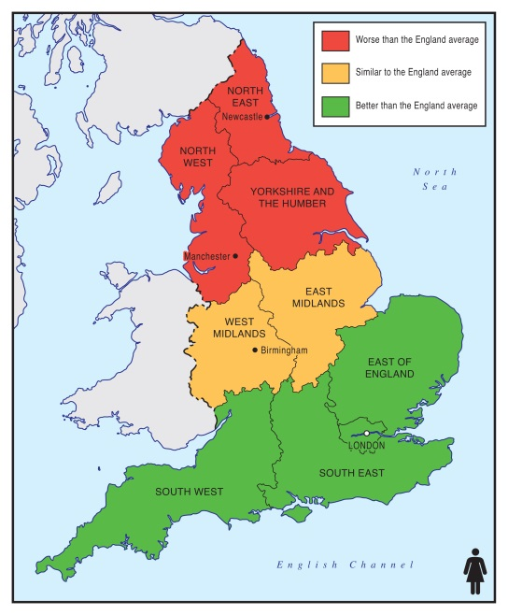
Equal North: how can we reduce health inequalities in the North?
Professor Clare Bambra
on behalf of the Equal North team

Slide 2
Equal North: Research and Policy Network
Help PHE take forward Due North by:
(1) Strengthening public health research in the North
(2) Enhancing the links between research and practice

Slide 3
Equal North
To set up a Northern Research Network of academics, policy and practice members
To map the skills and interests of members related to health and social inequalities research and practice Northern England.
To deliver Network meetings across the North – in NE, NW and Y&H.
To identify the priorities for future research and public health action to address health inequalities in the North via interviews and a Delphi exercise
To develop a multicentre Northern research consortium bid focused on reducing inequity in the North.

Slide 4
Today’s Agenda
10.00 | Registration and tea/coffee
10.30 10.45 | Introduction and overview Clare Bambra Keynote presentations introductions Chair: Clare Bambra
10.45 | Margaret Whitehead, WH Duncan Professor of Public Health, University of Liverpool The Due North Report
11.15 | Paul Johnstone, Regional Director, North of England, Public Health England Public Health England and the Due North Agenda
11.45 | Peter Kelly, Director of Public Health England North East Health inequalities, devolution and the North East
12.15 | Lunch and networking
13.30 | Workshops: Priority areas for health inequalities in the North
14.30 | Tea/coffee
15.00 | Panel discussion Chair: Eileen Kaner Panel Members: Clare Bambra, Jane Hartley, Margaret Whitehead, Paul Johnstone, Peter Kelly, Mark Shucksmith, Sohail Bhatti
15.30 | Meeting close Eileen Kaner

Slide 5
Social Games and Identity in the HE workplace
It offers an insight into how people try to adapt and fit in at work by looking at how value is attached to certain identities through the lens of class and gender.

